Slide 1



Introduction to Android
-Pradnya Mohite

Slide 2

Contents
Introduction
Android version and API Level
The Big picture
Comparison of DVM and JVM
Android Features
Application Fundamentals
Android Application Components

Slide 3
Introduction
  A Linux based Operating System designed primarily for touch screen mobile devices
  Initially developed by Android Inc
  and later purchased by Google in 2005
  The first Android powered device was sold in Oct 2008
  Android is Open Source and Google releases code under Apache2 license
  Google Play Store

Slide 4
Introduction
  A Linux based Operating System designed primarily for touch screen mobile devices
  Initially developed by Android Inc
  and later purchased by Google in 2005
  The first Android powered device was sold in Oct 2008
  Android is Open Source and Google releases code under Apache2 license
  Google Play Store

Slide 5

Open Android
What it means to be open and why would you care?
http://www.apache.org/licenses/LICENSE-2.0.html

Slide 6
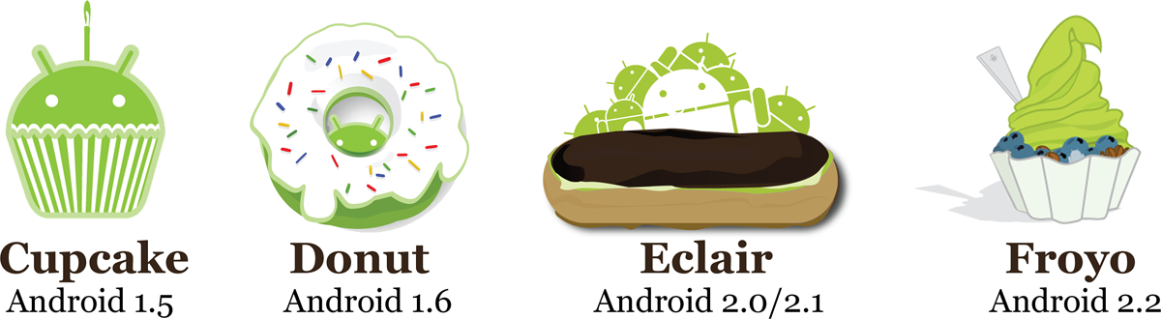
Brief History – Android
2009
  SDK 1.5 (Cupcake)
    New soft keyboard with “autocomplete” feature
  SDK 1.6 (Donut)
    Support Wide VGA
  SDK 2.0/2.0.1/2.1 (Eclair)
    Revamped UI, browser
2010
  SDK 2.2 (Froyo)
    Flash support, tethering
  SDK 2.3 (Gingerbread)
    UI update, system-wide copy-paste

Slide 7

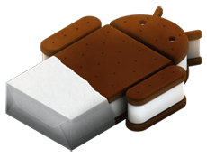

2011
  SDK 3.0/3.1/3.2 (Honeycomb) for tablets only
  New UI for tablets, support multi-core processors
  SDK 4.0/4.0.1/4.0.2/4.0.3 (Ice Cream Sandwich)
  Changes to the UI, Voice input, NFC
2012
  SDK 4.1/4.1.1/4.2(Jelly Bean)
  Performance optimization, refined UI
Honeycomb
Android 3.0-3.2
Ice cream Sandwich
Android 4.0+
Jelly Bean 4.1+

Slide 8
API Level
Platform Version | API Level | Version Name
Android 4.2 | 17 | Jelly bean
Android 4.1, 4.1.1 | 16 | Jelly bean
Android 4.0.3, 4.0.4 | 15 | Ice cream sandwich (Aakash)
Android 4.0, 4.0.1, 4.0.2 | 14 | Ice cream sandwich
Android 3.2 | 13 | Honey Comb
Android 3.1.x | 12 | Honey Comb
Android 3.0.x | 11 | Honey Comb
Android 2.3.4 Android 2.3.3 | 10 | Gingerbread

Slide 9
API Level
Platform Version | API Level | Version Name
Android 2.3.2 Android 2.3.1 Android 2.3 | 9 | Gingerbread
Android 2.2.x | 8 | Froyo
Android 2.1.x | 7 | Eclair
Android 2.0.1 | 6 | Eclair
Android 2.0 | 5 | Eclair
Android 1.6 | 4 | Donut
Android 1.5 | 3 | Cupcake

Slide 10
API Level
Android API levels can be divided to three main groups:
Android 1.5 - 2.3 (API levels 3-10) - Android made specifically for smartphones.
Android 3.0 - 3.2 (API levels 11-13) - Honeycomb, Android made for tablets.
Android 4 (API levels 14-) - Ice Cream Sandwich - Current generation, a big merge with tons of additional functionality, totally revamped Android version, for both phone and tablets.

Slide 11
Choosing API Level
Depends Device support
Application forward compatibility
Application backward compatibility

Slide 12
Version in Aakash Tablet
SDK 4.0.3 Ice Cream Sandwich
This can be found at:
Main menu->Settings->About tablet

Slide 13

The Big Picture(1)

Slide 14
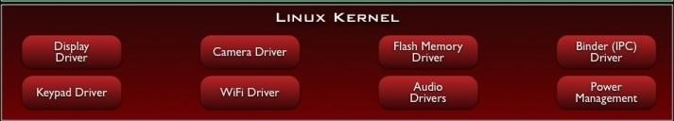
The Red Layer-
The Linux Kernel
Android runs on Linux
Linux provides hardware abstraction layer
Users never see Linux sub system
The adb command shell opens Linux shell
Aakash tablet (Linux kernel version is 3.0.8)

Slide 15
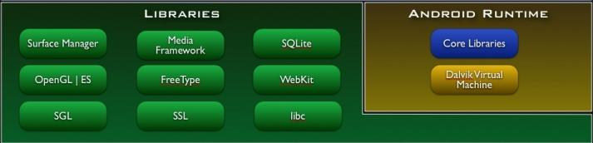
The Green Layer-
Native Libraries and Android Runtime
Pieces borrowed from other open source projects:
Webkit for fast HTML rendering
OpenGL for graphics
Media codecs
SQLite database
Dalvik Virtual Machine

Slide 16
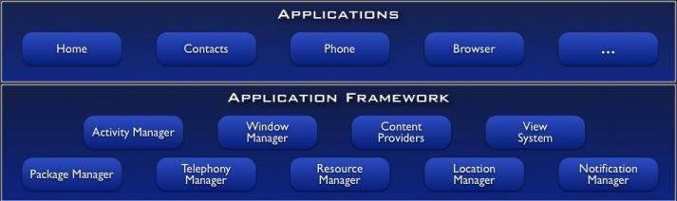
The Blue Layer-
Application Framework and Applications

Slide 17
Activity BackStack
Main activity calls activity2
backstack
Activity 2 is visible on screen
Main activity goes in background
main
Push Operation(Last in)
Activity 2

Slide 18
Activity BackStack
From activity2, user presses back button
backstack
Main activity is visible on screen and activity 2 is destroyed
main
Pop operation (First Out)
Activity 2

Slide 19
Java Source
Code
Java Source Code
Java
Compiler
Java
Compiler
Java Byte Code
Java Byte
Code
Dex
Compiler
Dalvik Byte Code
Java Byte Code
Dalvik Executable
JVM
DVM

Slide 20
Differences between DVM and JVM
Machine Property | DVM | JVM
Architecture base | Register | Stack
No of operations | fewer | more
File format | .dex | .class

Slide 21
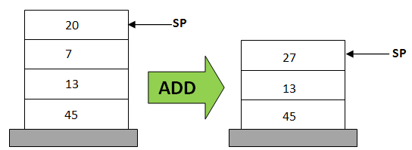
Stack Based
POP 20
POP 7
ADD 20, 7, result
PUSH result

Slide 22
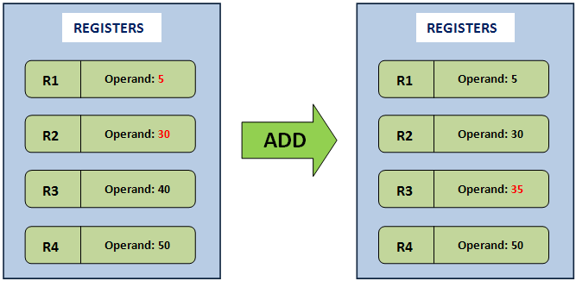
Register Based
Add R3,R1,R2

Slide 23
Android Java Consists of
Android Java
=
Java SE - AWT/Swing
+
Android API

Slide 24
Android Features
Application framework enabling reuse and replacement of components
Dalvik Virtual Machine optimized for mobile devices
Optimized graphics powered by a custom 2D graphics library; 3D graphics based on the OpenGL ES 1.0 specification (hardware acceleration optional)
SQLite for structured data storage
Wednesday, December 5, 2012

Slide 25
Media support for common audio, video, and still image formats (MPEG4, H.264, MP3, AAC, AMR, JPG, PNG, GIF)
GSM Telephony
(hardware dependent)
Bluetooth, 3G, and Wi-Fi , Wi-Fi Direct, Wi-Fi hotspot
(hardware dependent)
Camera, GPS, compass, and accelerometer
(hardware dependent)
Wednesday, December 5, 2012

Slide 26
Aakash Tablet Features
Android 4.0(Ice Cream Sandwich)
Optimized graphics support
Wi-Fi
Camera
Accelerometer
SQLite
Media Support

Slide 27
Application Fundamentals
APK file format:
  Application package file
  Zip package format based on JAR file format
  Apk holds
    Code(.dex file)
    Resources
    Assets
    Certificates
    Manifest file

Slide 28
Application Fundamentals.......(2)
Once .apk is installed on a device:
  Own security sandbox
  A unique Linux UserID
  Own Virtual Machine
  Own Linux process

Slide 29
Android Application Components
Activities
Services
Content Providers
Broadcast Receivers

Slide 30
Activity
An Activity is an application component that provides a screen with which users can interact in order to do something
An activity is implemented as Subclass of Activity

Slide 31
Services
A Service is an application component that can perform long-running operations in the background and does not provide a user interface.
A service is implemented as a subclass of Service

Slide 32
Content Providers
A content provider manages a shared set of application data
A content provider is implemented as a subclass of ContentProvider

Slide 33
Broadcast Receivers
A broadcast receiver is a component that responds to system-wide broadcast announcements.
A broadcast receiver is implemented as a subclass of BroadcastReceiver

Slide 34
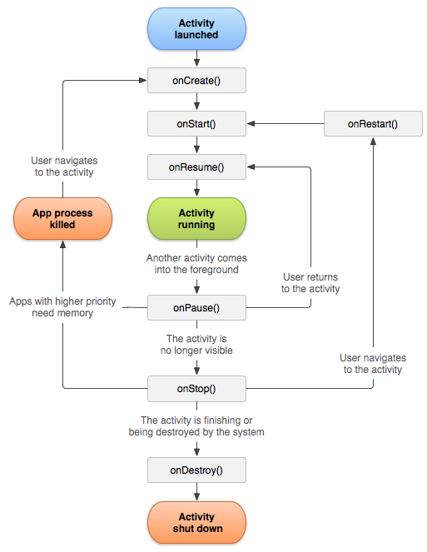
(2)

Slide 35
Summary
Android Version and API
Android architecture
DVM Vs JVM
Android features
Android building blocks

Slide 36
References
(1) http://developer.android.com/about/versions/index.html
(2) http://developer.android/reference/android/app/Activity.html

Slide 37
Thank You

